Slide 1
Project Part - II (AUE-893)
VISHAL PRASAD
11603217017

Slide 2
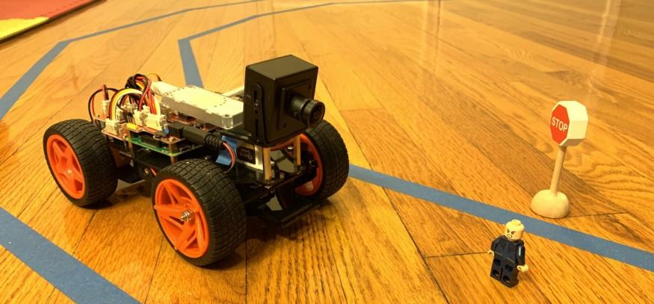
Self Driving (DeepPi) Car Simulation
with Lane Detection and Object (such as Pedestrians and Traffic Lights)
detection capabilities

Slide 3
Contents
From Automobiles to Auto Mobility!
History of Self Driving Cars
Tasks to be performed
Lane Detection
Initial steps of Lane Detection
Reduce Noises in the Image (Gaussian Blur)
Finding Edges (Canny Edge Detector)
Detection of Straight Line in Region of Focus (Hough Transform)
Lane Detection on a Video
Object Detection
Facebook AI’s DETR Method
Proposed Framework
Methods and Experiment
Demonstration of the Code
References

Slide 4
From Automobiles to Auto Mobility!
Self-Driving cars are poised to revolutionize the transportation
industry
Self-driving cars are closer & closer to becoming reality, with LEVEL 5 autonomy the vehicles will impact largely to the humanity & society. Some we can imagine and some can only be dream about:
It will help children, elderly and people who can’t drive, allow them to reach from one place to another at any time
It will reduce the occurrence of Automotive Accidents (due to human error). Thus the roads will be safer and less congested
It will allow the busy people during their commute to utilize their time working on projects on their way to the office or watching a favorite television show on an in-vehicle entertainment system, etc.
Buckle up. Bumpy roads ahead.

Slide 5
History of Self Driving Cars
Trials on Automated Driving system started in 1950s
First semi automated was developed in 1977 by Japan's Tsukuba Mechanical Engineering Laboratory
A landmark autonomy achieved in 1980s
by the Carnegie Mellon University’s Navlab and ALV (in 1984)
and by Bundeswehr University Munich’s EUREKA Prometheus Project and Mercedes-Benz (in 1987)
From then, the era of self-driving cars has started
In March 2019 Robocar set the Guinness World Record for being the fastest (@282.42 km/h) autonomous car in the world
On March 5, 2021 Honda began a limited edition of 100 Legend Hybrid EX sedans equipped with the newly approved Level 3 automation

Slide 6
Tasks to be performed
The research projects deals with two major challenges. These are as follows:
Lane Detection
Lane detection is the task of detecting lanes on a road from real time videos while driving
The task is to build a program which can identify lane line in a picture or in a video
Object Detection
Object detection is the task of detecting objects (such as humans, traffic signs, or cars) on a road in digital images and videos while driving
The task is to use computer vision (OpenCV) to identify image annotation, face detection, face recognition etc.

Slide 7
Lane Detection
For the implementation of an end to end lane detection algorithm, the full task is divided into a number of sub tasks which are as follows:
Reading image
Convert image into Grayscale
Reduce Noise by applying Gaussian Blur method
Finding the edges by using Canny Edge Detector algorithm
Detection of the straight line in the Region of Interest also called the Hough Transformation
Lane detection algorithm applied on a real-time road video to bring the output

Slide 8
Initial steps of Lane Detection
Reading Image
First we need to install the OpenCV library and import cv2 from the library to read the image downloaded in our system. The image will be transformed into its binary equivalent. We can also see the image from the program by using
Convert the image into Grayscale (Black & White)
Images are made up of pixels. A colored image is by overlapping three images on one another, each of Red, Green and Blue of different pixel intensities. Converting the image to grayscale (black and white) image reduces the size of the image which is reduces the processing time making it less computation intensive

Slide 9
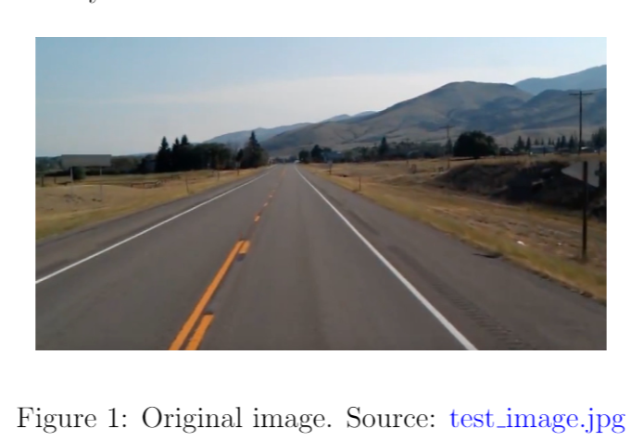
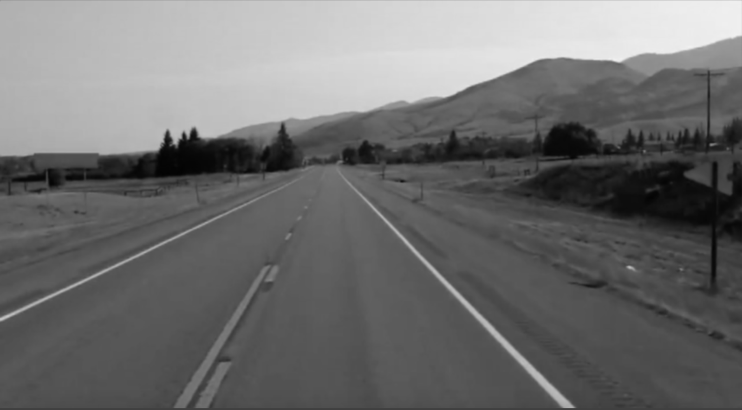
Reduce Noises in the Image (Gaussian Blur)
Image noise are unwanted edges which are detected while applying the algorithm. The noises are filtered to smoothen the image by Gaussian blur method
Figure 2: Grayscale blurred image (Gaussian Blur image)

Slide 10
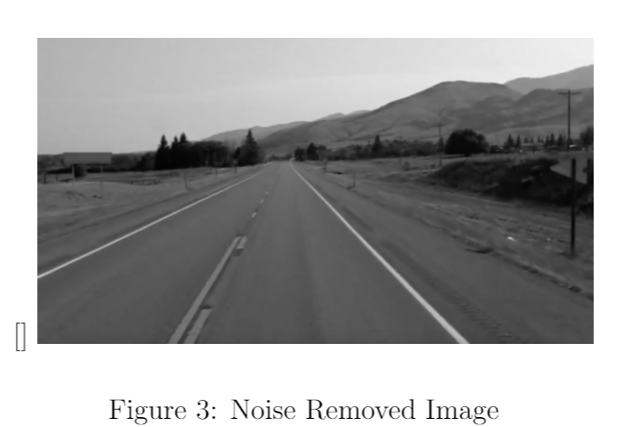
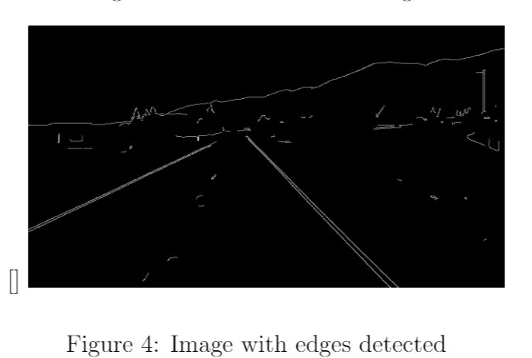
Finding Edges (Canny Edge Detector)
A sharp change in the intensity of an image corresponds to the edge. The Canny edge detector algorithm is used to detect the edges

Slide 11
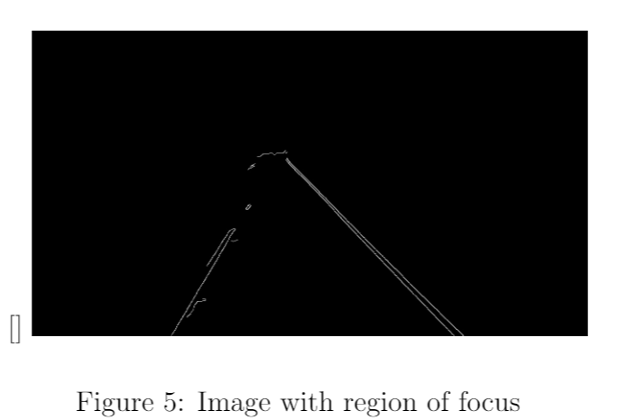
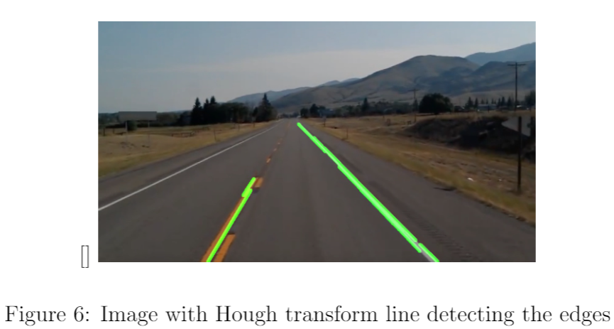
Detection of Straight Line in Region of Focus (Hough Transform)
In the region of interest the detection of straight line (points which are connected in a straight). One of the approach is by using Hough transform

Slide 12
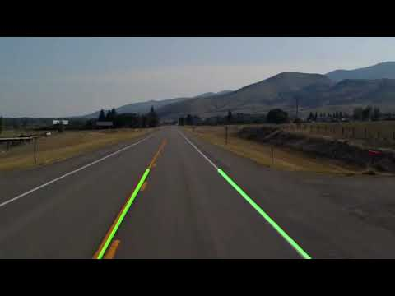
Lane Detection on a Video
This is the final step. I have now applied the similar algorithm with minor changes to see the output on a video image of a road

Slide 13
Object Detection
The Object Detection is the task of detecting instances of semantic objects of a certain class (such as humans, buildings, or cars) in digital images and videos.
One of the challenges for making driving autonomous is to able to predict the different obstacles on the road.
Object Detection Models:
You Only Look Once (YOLO)
Haar Cascade Algorithm
DEtection TRansformer (DETR)
etc.

Slide 14
DEtection TRansformer (DETR) by Facebook AI
Introduction - Background
Propose a direct set prediction approach to bypass the surrogate tasks
Adopt an encoder-decoder architecture based on transformers
DEtection TRansformer (DETR) predicts all objects at once in end-to-end manner, with a set loss function which performs bipartite matching between predicted and GT objects
DETR are the conjugation of the bipartite matching loss, transformers with parallel decoding

Slide 15
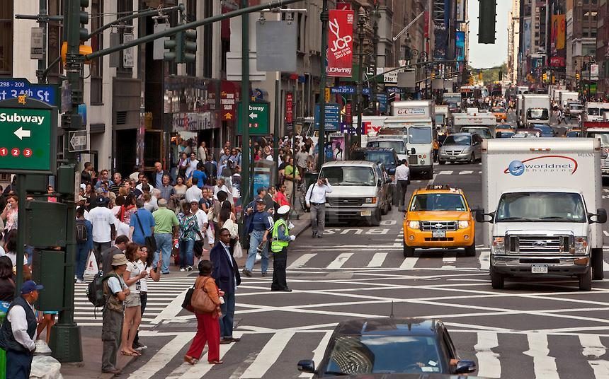
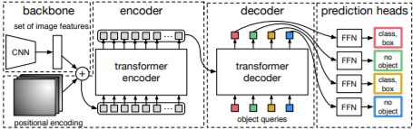
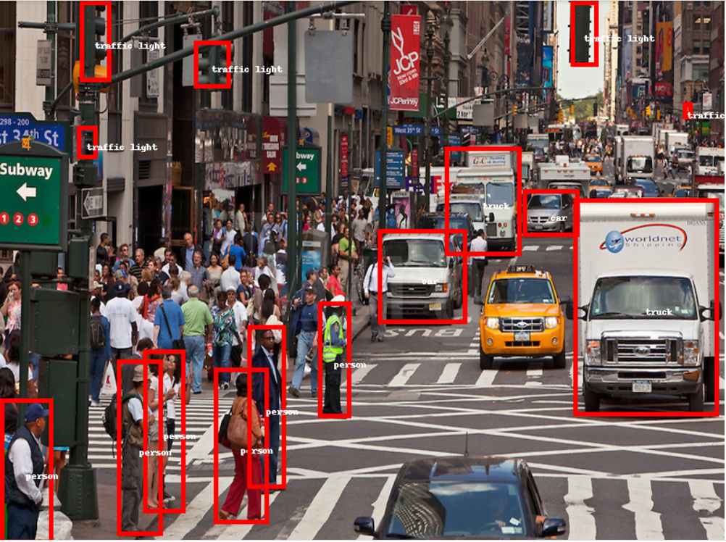
Proposed Framework
Objects detected with different classes (such as traffic light, person, truck, car etc.) from the given raw image

Slide 16
Methods and Experiments
Proposed Framework
Backbone: Conventional CNN backbone that extract a compact feature representation
Transformer: 1x1 conv reduces the channel dimension → Flattens vector and add positional encodings to the input of each attention layer → Each encoder consists of multi-head self attention model and FFN
Transformer decoder: Transforms N input embeddings using multi-headed self and encoder-decoder attention mechanisms
Feed-Forward Networks (FFN): 3-layer perception with ReLU activation function and linear projection layer. It predicts the normalized centre coordinates, height, and width of the box, and class label using softmax function.

Slide 17
To demonstrate the simplicity of the approach, I am including inference code with PyTorch and Torchvision libraries. The code runs with Python 3.6+, PyTorch 1.4 and Torchvision 0.5.
Website:
https://colab.research.google.com/drive/1wCLxKiBCSFSoQDAJh9DjSkGpmoKVQ1jc?usp=sharing

Slide 18
References
OpenCV Python Tutorial - Find Lanes for Self-Driving Cars (Computer Vision Basics Tutorial)
Self-driving car
(DeepPiCar): How to Build a Deep Learning, Self Driving Robotic Car on a Shoestring Budget
Driving Disrupted: Driverless Cars Change Everything
facebookresearch/detr
DETR: End-to-End Object Detection with Transformers (Paper Explained)
End-to-End Object Detection with Transformers
Get started with Google Colaboratory

Slide 19



For any queries/ feedback
vishalprasad95@gmail.com
https://github.com/vishalprasad95

